Slide 1
HOUSING : PRICE PREDICTION
By, UTKARSH VARDHAN

Slide 2
Background and Problem Statement:
Houses are one of the necessary need of each and every person around the globe and therefore housing and real estate market is one of the markets which is one of the major contributors in the world’s economy.
It is a very large market and there are various companies working in the domain. Data science comes as a very important tool to solve problems in the domain to help the companies increase their overall revenue, profits, improving their marketing strategies and focusing on changing trends in house sales and purchases. Predictive modelling, Market mix modelling, recommendation systems are some of the machine learning techniques used for achieving the business goals for housing companies.
A US-based housing company named Surprise Housing has decided to enter the Australian market. The company uses data analytics to purchase houses at a price below their actual values and flip them at a higher price.

Slide 3
Background and Problem Statement:
For the same purpose, the company has collected a data set from the sale of houses in Australia. The data is provided in the CSV format.
The company is looking at prospective properties to buy houses to enter the market.
We are required to build a model using Machine Learning in order to predict the actual value of the prospective properties and decide whether to invest in them or not.
For this company wants to know:
Which variables are important to predict the price of variable?
How do these variables describe the price of the house?

Slide 4
Business Goal
We are required to model the price of houses with the available independent variables.
This model will then be used by the management to understand how exactly the prices vary with the variables.
They can accordingly manipulate the strategy of the firm and concentrate on areas that will yield high returns.
Further, the model will be a good way for the management to understand the pricing dynamics of a new market.

Slide 5
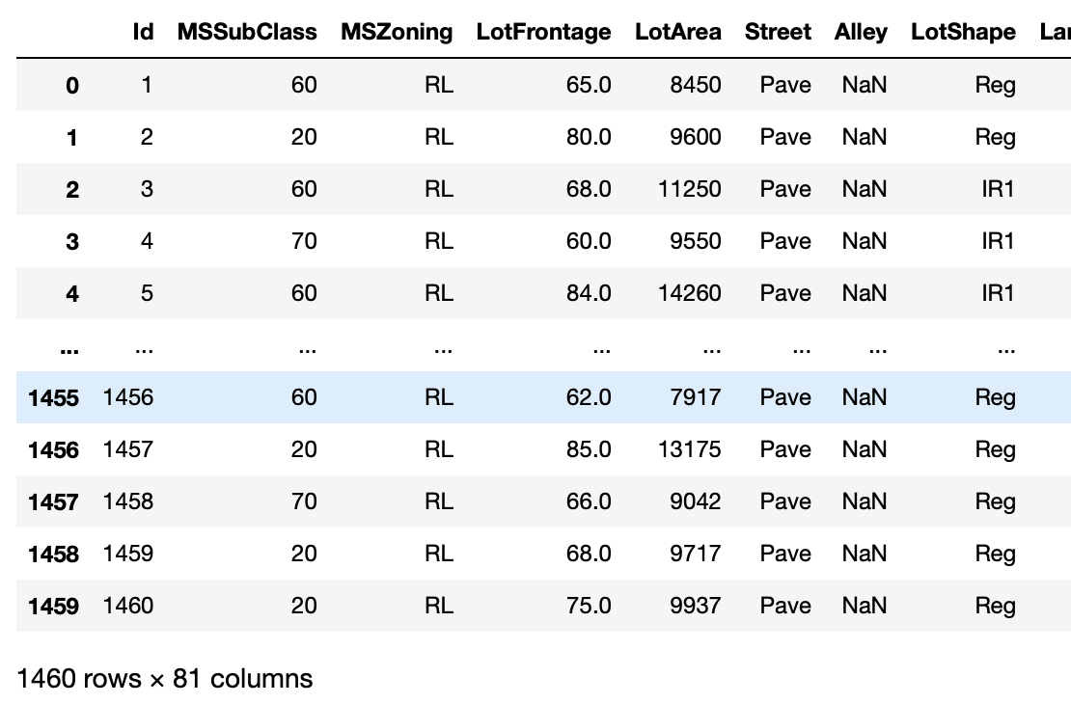
Data Shared
Data contains 1460 entries each having 81 variables.
Data contains Null values.
Data contains numerical as well as categorical variable.
Data File is in csv format

Slide 6
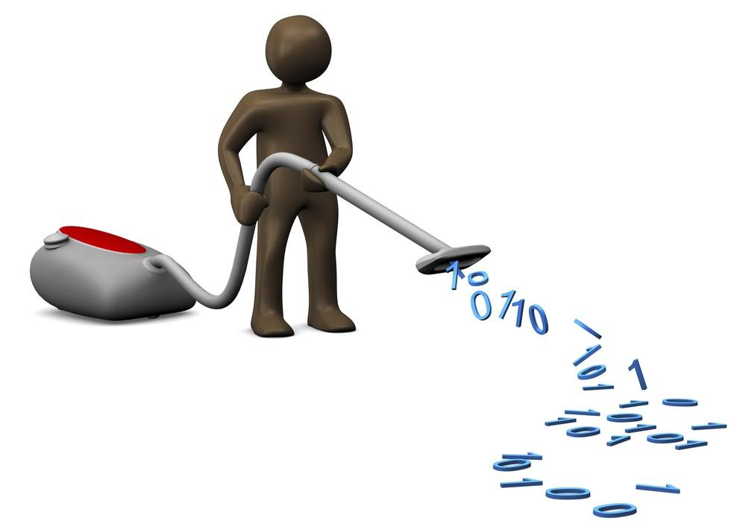

Data Cleaning
PCA
Removing Outliers
Checking for correlation Features
Checking Missing Values
Dropping Columns
Checking Uniqueness
Checking Shapes and Data Types

Slide 7
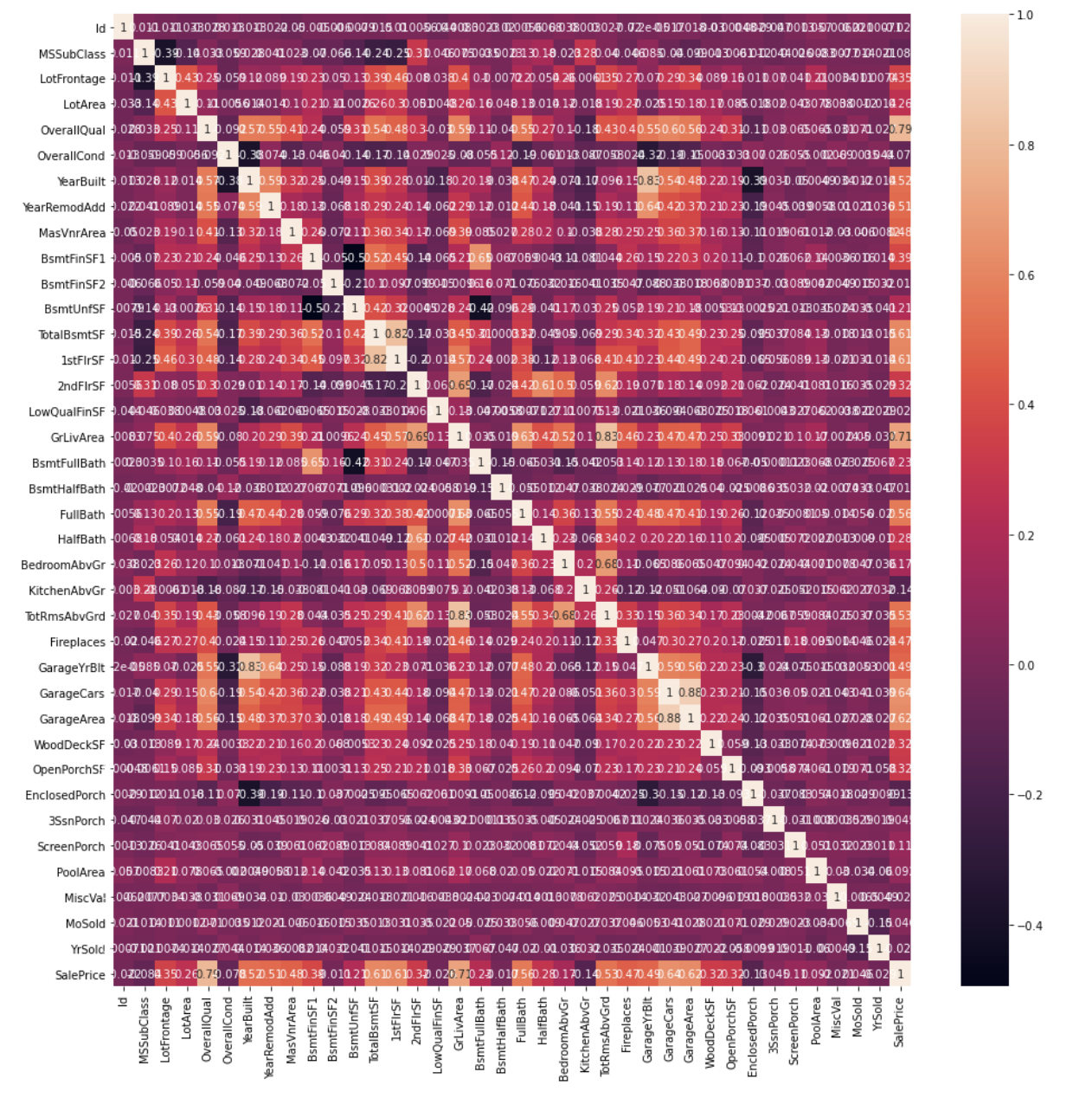
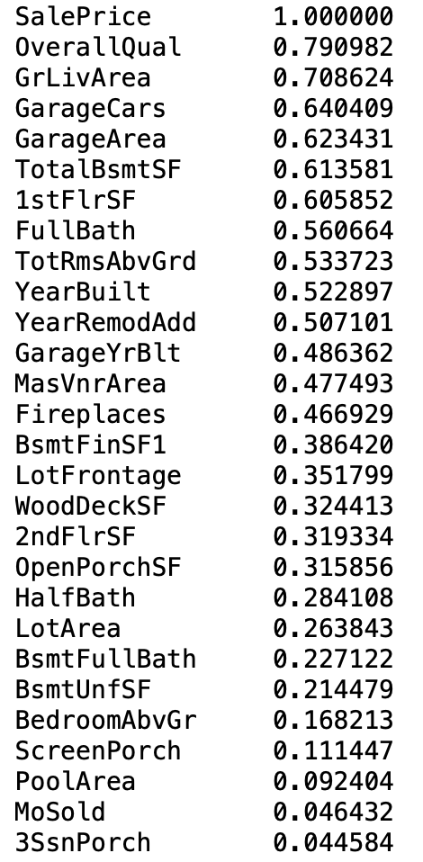
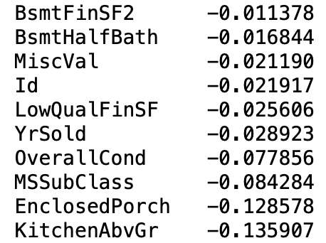
Data Visualization:

Slide 8
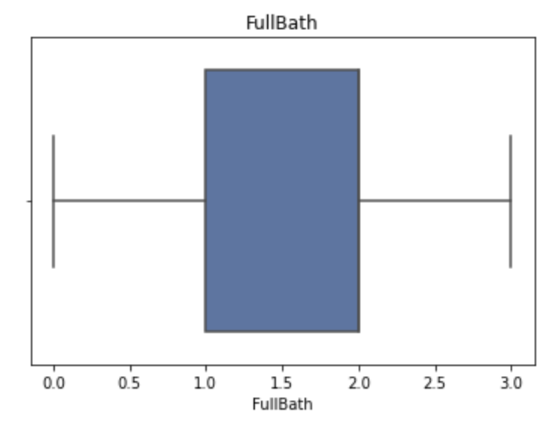
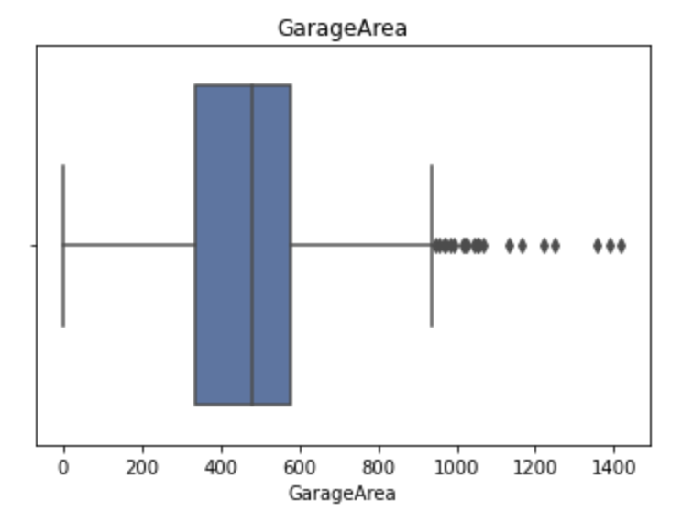
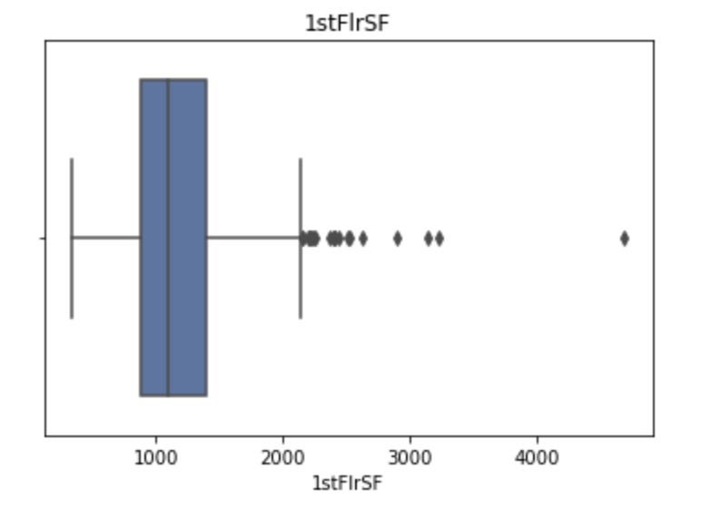
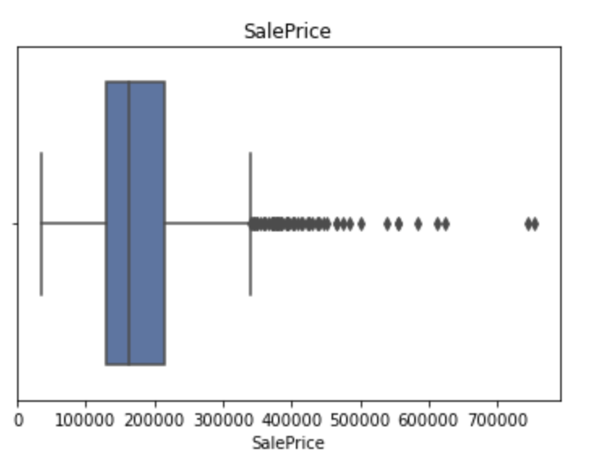
Data Visualization:

Slide 9
MODEL TESTING:
MODELS | ACCURACY | CROSS VAL SCORE
DecisionTreeRegressor | 76.51% | 59.65%
RandomForestRegressor | 97.08% | 73.38%
Lasso | 92.24% | 88.6%
KNeighborsRegressor | 75.48% | 66.36%
LinearRegression | 92.24% | 88.61%

Slide 10
THANK YOU

